Slide 1


Bangladesh Army University of Engineering & Technology
Department of Computer Science and Engineering
EEE 2261: Electrical Drives and Instrumentation
Winter 2025 Semester
Lecture-02, 03 & 04
Course Teacher
S. M. Ashik Al Mashrafi
Lecturer, EEE, BAUET
Total Credit: 3.0 Credit Taking: 3.0

Slide 2

Course Content
Chapter | Topics
Introduction | Three phase circuits, alternators and transformers, principles & operation of DC Machines, synchronous, induction, universal and stepper motors, thyristor and microprocessor-based speed control of motors
Instrumentation Amplifiers | Differential, logarithmic, and chopper amplifiers, frequency and voltage measurements using digital techniques, recorders and display devices, spectrum analyzers and logic analyzers, data acquisition and interfacing to microprocessor-based systems;
Transducers | Terminology, types of transducers, principles and applications of photovoltaic, piezoelectric, thermoelectric, variable resistance and opto-electronics transducers. Noise reduction in instrumentation

Slide 3
Three Phase System
Since both the three-phase source and the three-phase load can be either wye- or delta-connected, we have four possible connections:
Y-Y connection (i.e., Y-connected source with a Y-connected load).
Y-Δ connection.
Δ-Y connection.
Δ-Δ connection.

Slide 4
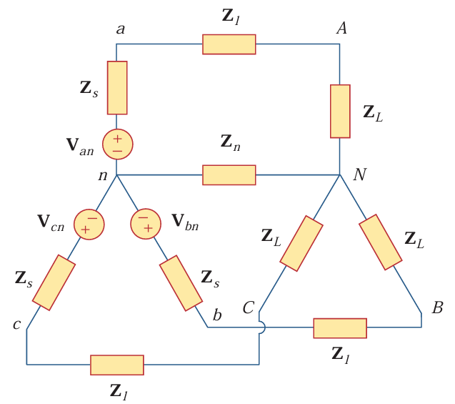
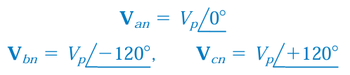

Balanced Wye-Wye Connection
A balanced Y-Y system is a three-phase system with a balanced Y-connected source and a balanced Y-connected load.
Phase Voltage:
Fig. 1: A balanced Y-Y system, showing the source, line, and load impedances.

Slide 5
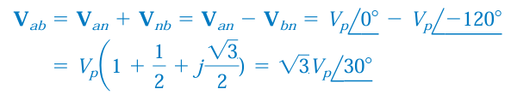


Balanced Wye-Wye Connection
Line Voltage:
Fig. 1: A balanced Y-Y system, showing the source, line, and load impedances.

Slide 6
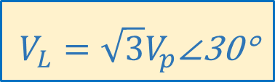

Balanced Wye-Wye Connection
$$V_{L}=\sqrt{3}V_{p}\text{∠}\text{30}\text{°}$$
$$I_{L}=I_{p}$$
Fig. 1: A balanced Y-Y system, showing the source, line, and load impedances.

Slide 7
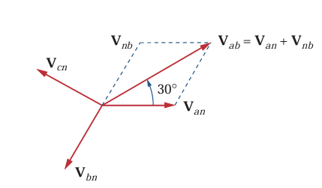
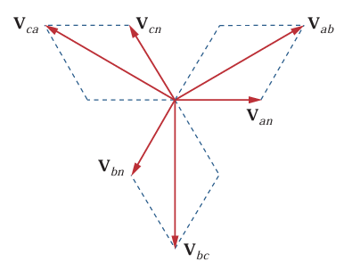
Balanced Wye-Wye Connection
Fig. 1: A balanced Y-Y system, showing the source, line, and load impedances.
Fig. 3: Phasor diagram of line voltage and phase voltage of abalanced Y-Y system.

Slide 8
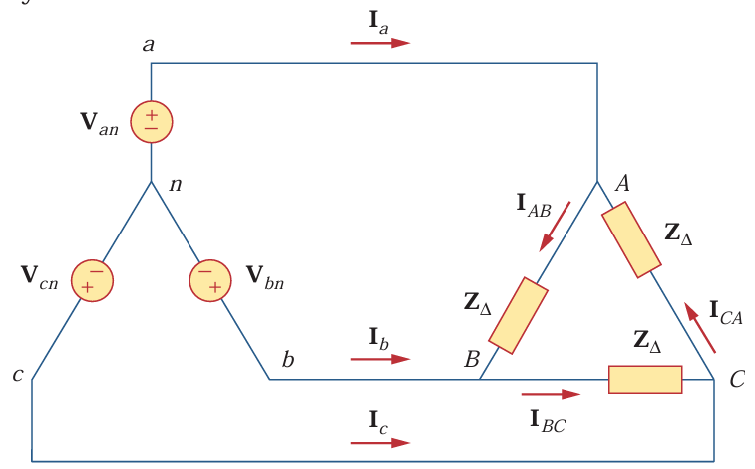
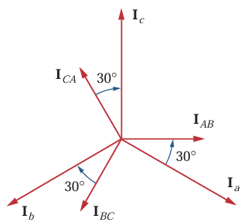
Balanced Wye-Delta Connection
Fig. 4: A balanced Y- Δ system.
Fig. 5: Phasor diagram of line current and phase current of a balanced Y- Δ system.

Slide 9
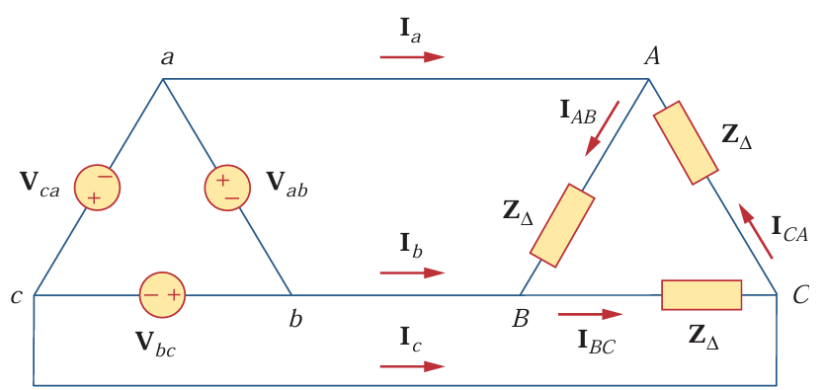
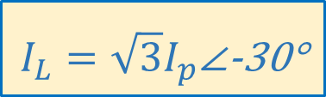

Balanced Delta-Delta Connection
$$V_{L}=V_{p}$$
$$I_{L}=\sqrt{3}I_{p}\text{∠}\text{−30}\text{°}$$
Fig. 3: A balanced Δ - Δ system.

Slide 10
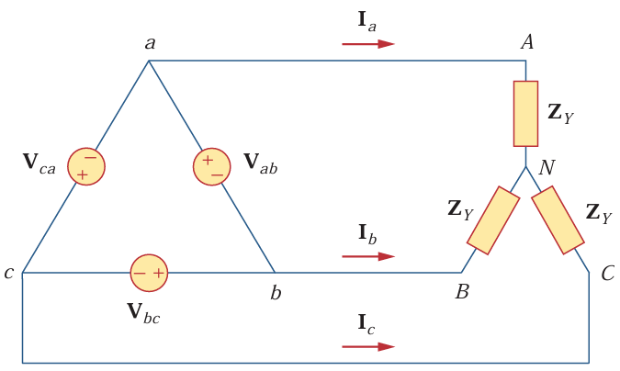
Balanced Delta-Wye Connection
$$V_{L}=V_{p}$$
$$I_{L}=I_{p}$$
Fig. 4: A balanced Δ - Y system.

Slide 11
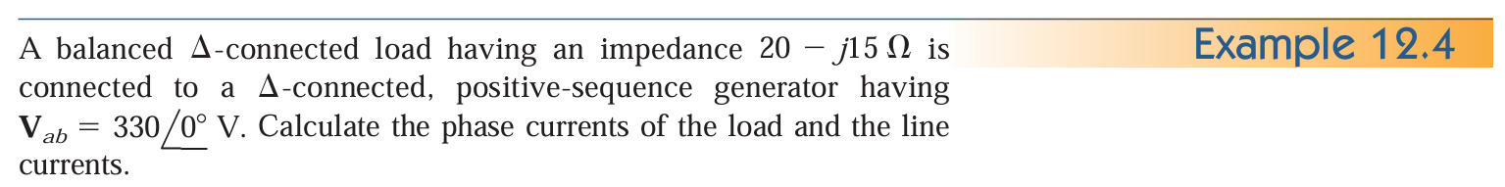



Balanced Delta-Wye Connection
20-j15Ω
20-j15Ω
$$330\text{∠}\text{+12}\text{0}\text{°} \text{V}$$
$$330\text{∠}\text{0}\text{°} \text{V}$$
20-j15Ω
$$330\text{∠}\text{−120}\text{°} \text{V}$$
Fig. 5: Circuit diagram of Example 12.4.

Slide 12
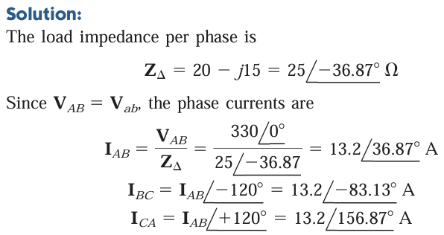



Balanced Delta-Wye Connection
20-j15Ω
20-j15Ω
$$330\text{∠}\text{+12}\text{0}\text{°} \text{V}$$
$$330\text{∠}\text{0}\text{°} \text{V}$$
20-j15Ω
$$330\text{∠}\text{−120}\text{°} \text{V}$$
Fig. 5: Circuit diagram of Example 12.4.

Slide 13
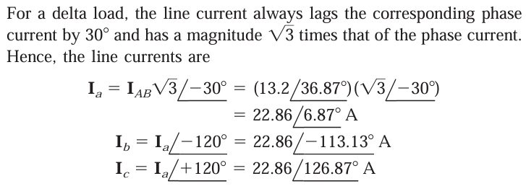
Balanced Delta-Wye Connection
20-j15Ω
20-j15Ω
$$330\text{∠}\text{+12}\text{0}\text{°} \text{V}$$
$$330\text{∠}\text{0}\text{°} \text{V}$$
20-j15Ω
$$330\text{∠}\text{−120}\text{°} \text{V}$$
Fig. 5: Circuit diagram of Example 12.4.

Slide 14
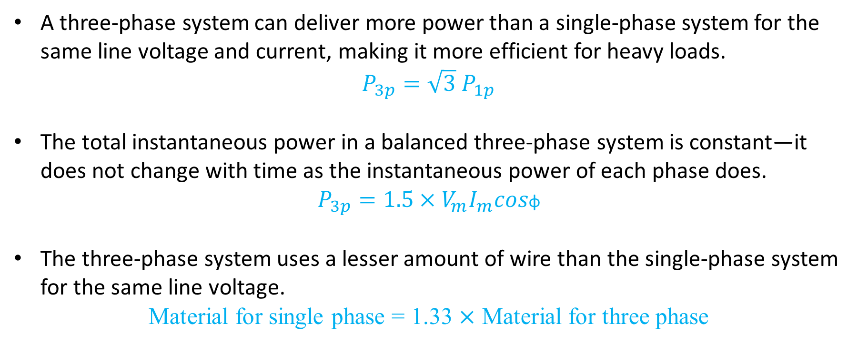
Why three phase is needed?
A three-phase system can deliver more power than a single-phase system for the same line voltage and current, making it more efficient for heavy loads.
$P_{3p}=\sqrt{3}$ $P_{1p}$
The total instantaneous power in a balanced three-phase system is constant—it does not change with time as the instantaneous power of each phase does.
$$P_{3p}=1.5×V_{m}I_{m}cos\text{φ}$$
The three-phase system uses a lesser amount of wire than the single-phase system for the same line voltage.
Material for single phase = 1.33 $×$ Material for three phase

Slide 15
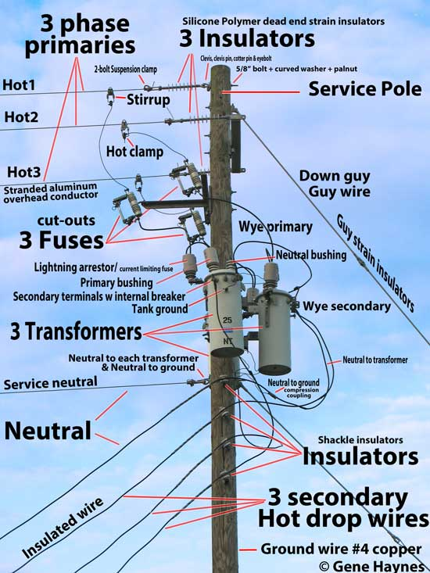
Three phase system
Phase A
Phase B
Phase C
Neutral

Slide 16
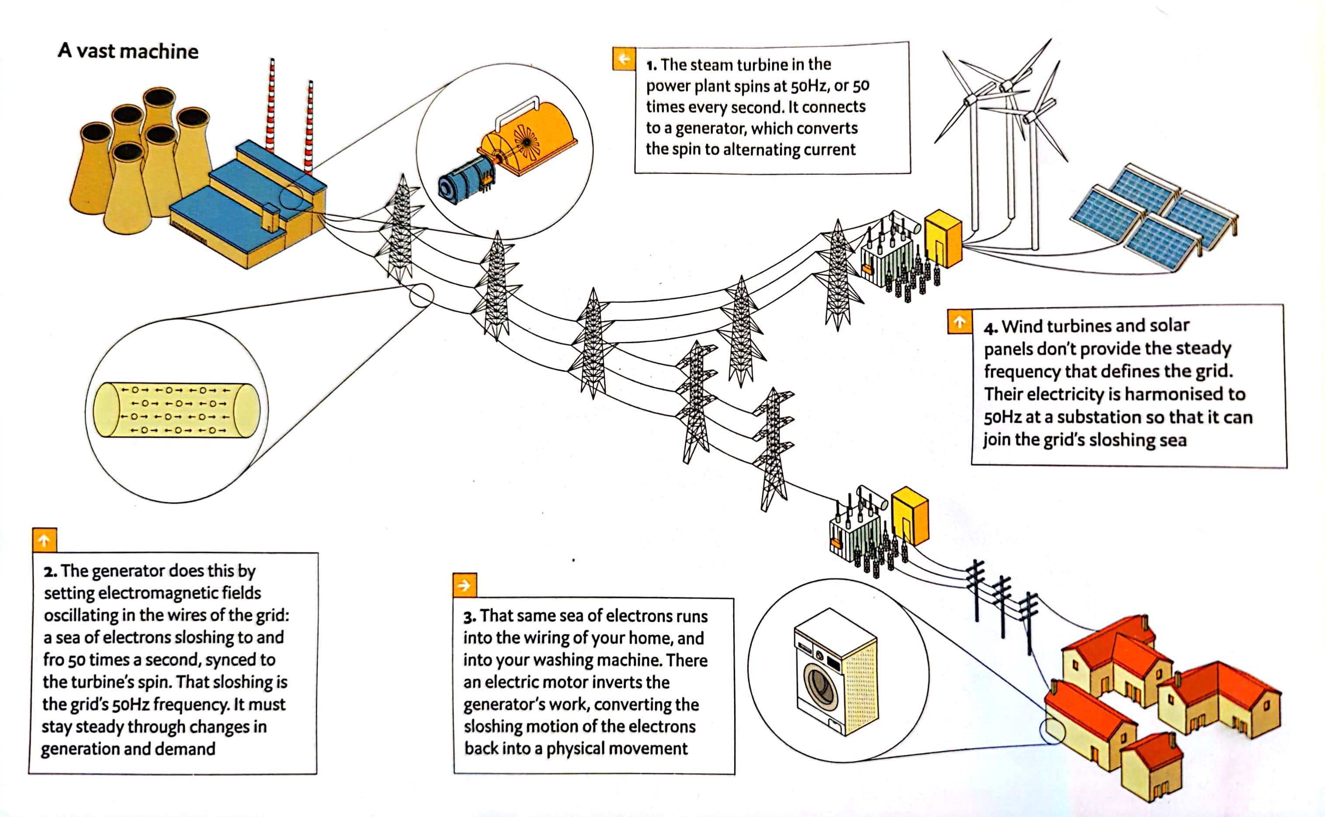
Three phase system

Slide 17


